Slide 1
Anonymous Authorship Identification
Daway Chou-Ren
Mentor: Byron Gao

Slide 2
Three-fold Problem
Author identification with large samples
The Federalist Papers – Hamilton, Madison, or Jay?
Author identification with small samples
Tweets, Facebook posts, forum posts, limited number of emails
Author characterization
Gender, age, education, location, nationality

Slide 3
Existing Literature
Variety of statistical models created
Neural networks, bayesian analysis, k-clustering, support vector machines1993: neural networks (small feature sets)
1994: naïve Bayes
1995: k-nearest neighbor
1995: rule learners
2001: support vector machines
2005: neural networks (large feature sets)
2006: Bayesian regression

Slide 4
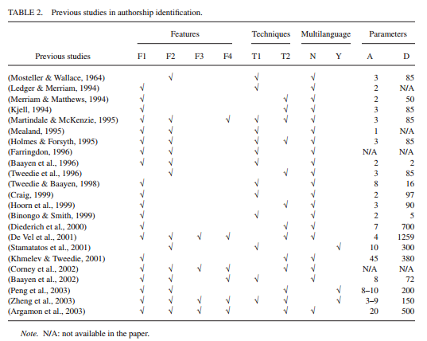
Zheng, 2006

Slide 5
Writeprints
Karhunen-Loeve transforms-based technique that uses a sliding window and pattern disruption algorithm (Abbasi, 2008)
Extended by Iqbal, et all (2010, 2013)
Identifies prominent stylometric features in writing unique to that author, creating a “fingerprint”
Outperforms support vector machines, ensemble SVMs, other transforms
88% accuracy for four anonymous suspects (Iqbal, et al 2013)
70% for 20 suspects

Slide 6
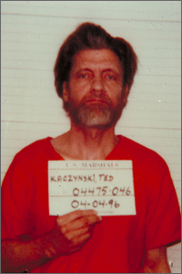
The Unabomber
Ted Kaczynski
Killed three people, injured 23 others with homemade bombs over a period of 17 years
Uncovered by family members who read his 35,000 word manifesto and recognized the writing style

